Slide 1
Novel Organic Biomimetic Lattice Structure for Bone Analogous Applications
Department of Mechanical Engineering
Indian Institute of Technology Tirupati
B.Tech. Final Year Project Presentation
Raunak Yadav ME22B044
Somil Gera ME22B051
Supervised by
Dr. Abir Dutta, Department of Mechanical Engineering

Slide 2
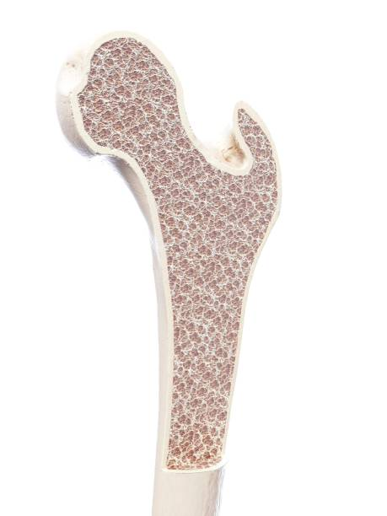
Background and Motivation
Bone is a load‑bearing biological material
Conventional implants are much stiffer than bone leading to stress shielding which causes:
  Bone resorption
  Implant loosening
  Failure over time
Natural bone is:
  Porous
  Hierarchical
  Functionally graded
Need of structures that replicate bone using geometry, not just material

Slide 3
Objectives
Compare multiple lattice structures for bone scaffolds
Lattices studied: SC, BCC, FCC, Fluorite
Investigate effect of strut thickness:
  0.75 mm
  1.0 mm
Apply identical geometry and loading for all cases
Compute Effective Young’s Modulus using deformation
Identify lattice closest to femoral bone stiffness

Slide 4
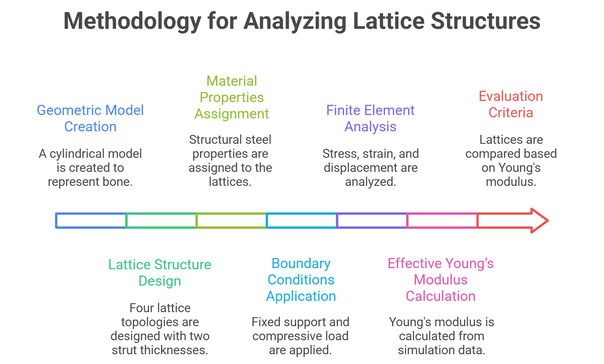
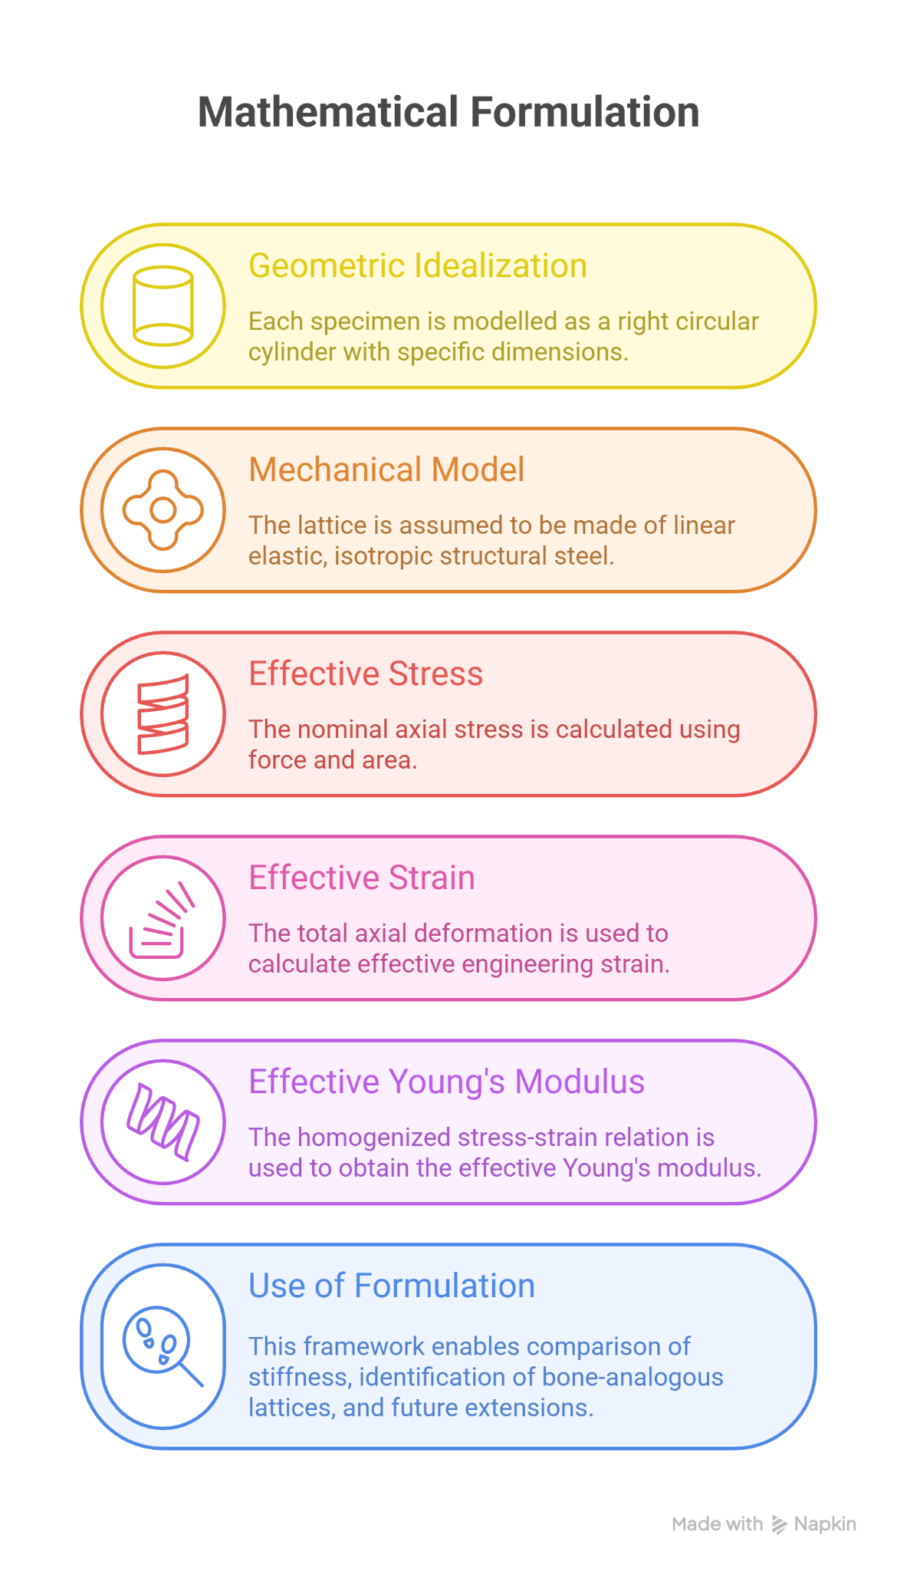
Methodology and Formulation
Methodology for Analyzing Lattice Structures
Mathematical Formulation

Slide 5
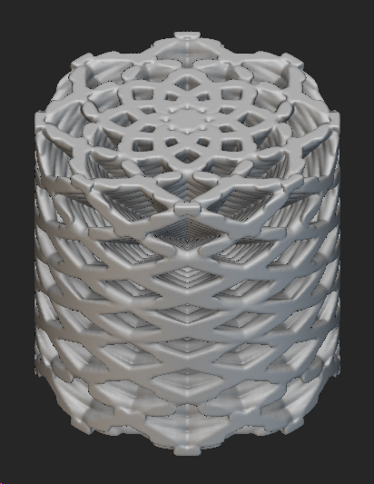
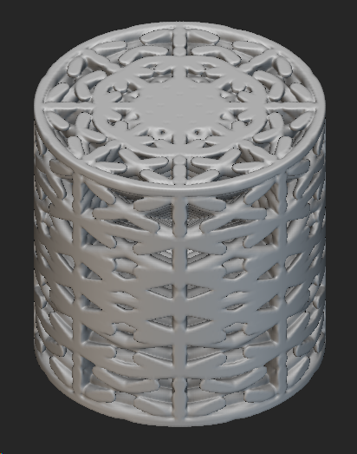
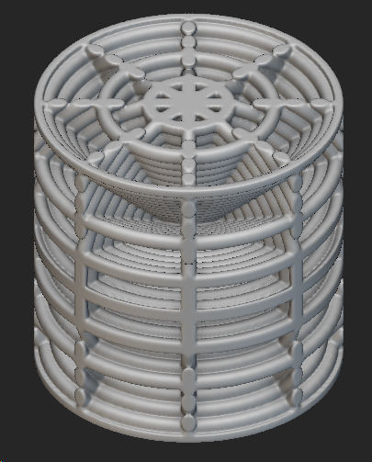
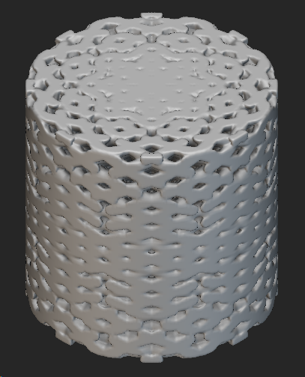
Types of Lattice Structures
Four lattice topologies were studied:
Body Centered Cubic (BCC)
Face Centered Cubic (FCC)
Simple Cubic
Fluorite Lattice

Slide 6
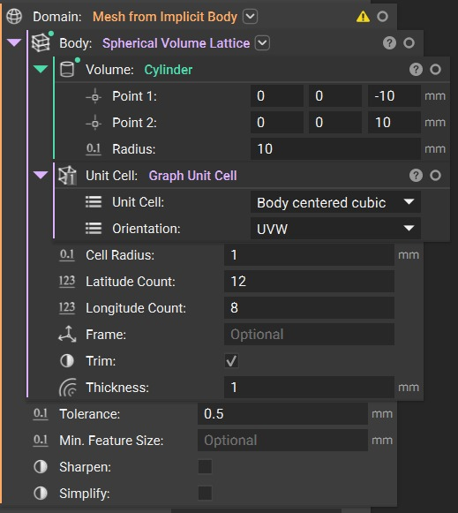
Lattice Generation Workflow
Base geometry creation (20mm x 20mm cylinder)
Selection of lattice topology (SC / BCC / FCC / Fluorite)
Unit cell definition
Strut thickness assignment (0.75 mm, 1.0 mm)
Lattice population within geometry
Final lattice model output

Slide 7
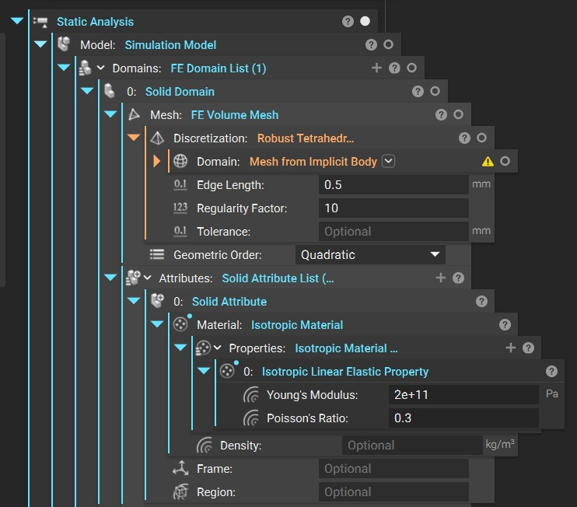
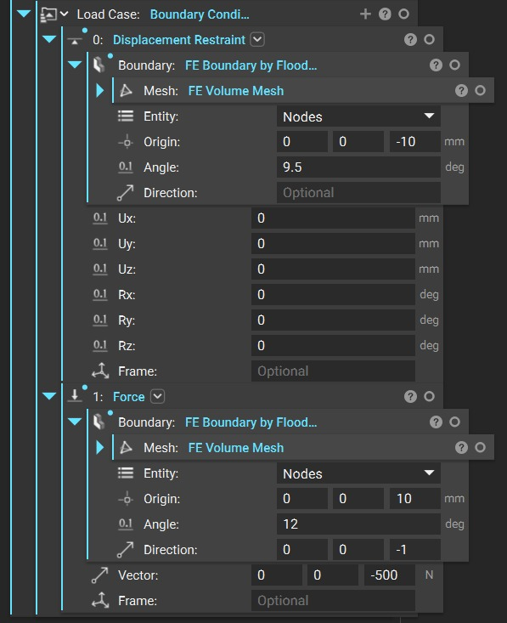
Simulation Setup
Boundary Conditions:
• Bottom face fixed
• 500 N axial load on top surface
Outputs Extracted:
• Directional deformation
• Stress & strain contours
Simulation Setup for BCC lattice with 1mm strut thickness

Slide 8
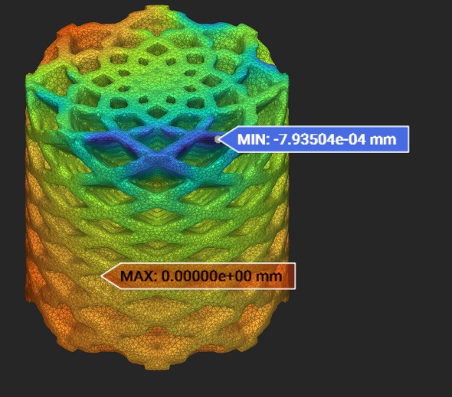
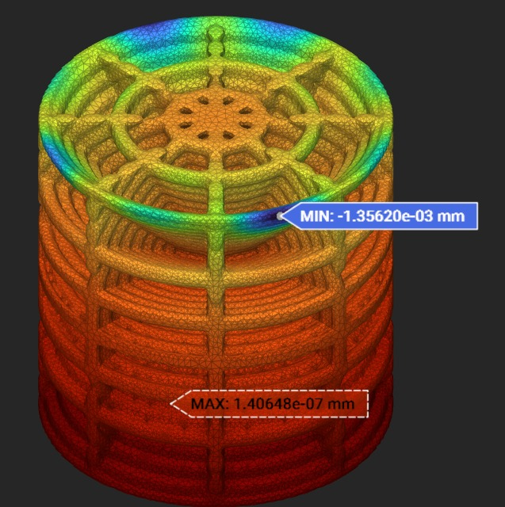
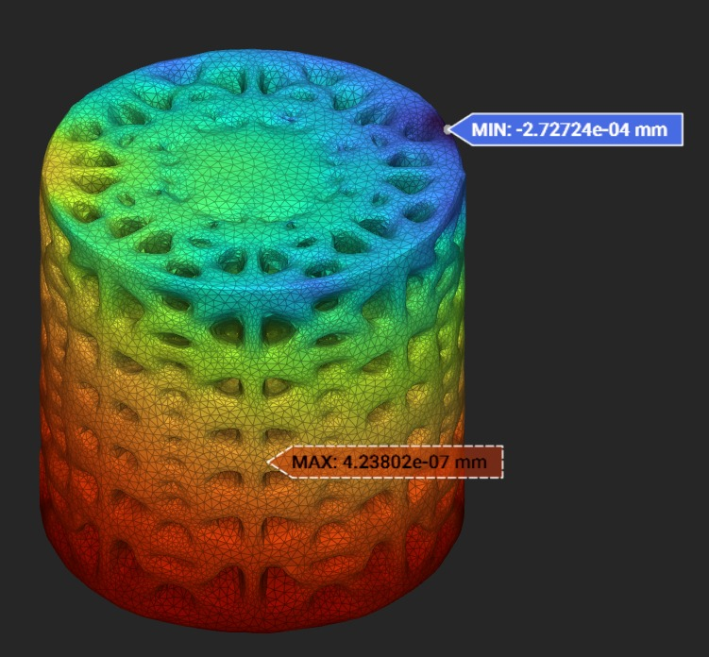
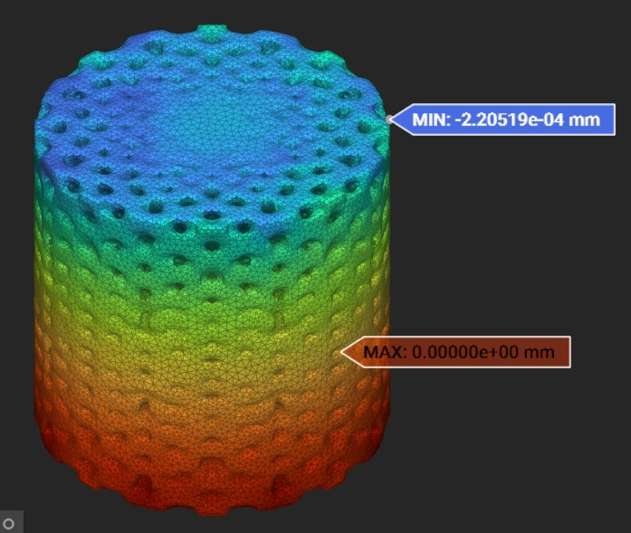
Displacement Field Results
For 1 mm strut thickness
BCC
Max displacement = 7.935 X 10⁻⁴ mm
SC
Max displacement = 1.3562 X 10⁻³ mm
FCC
Max displacement = 2.7272 X 10⁻⁴ mm
Fluorite
Max displacement = 2.2051 X 10⁻⁴ mm

Slide 9
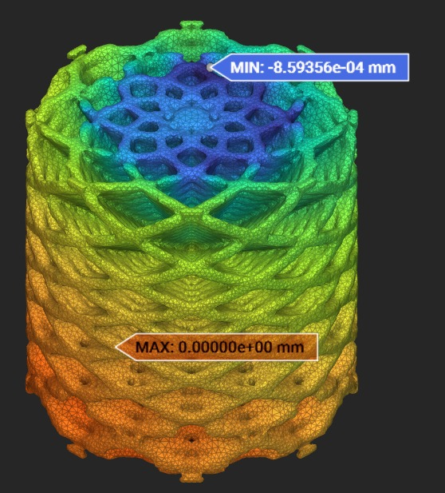
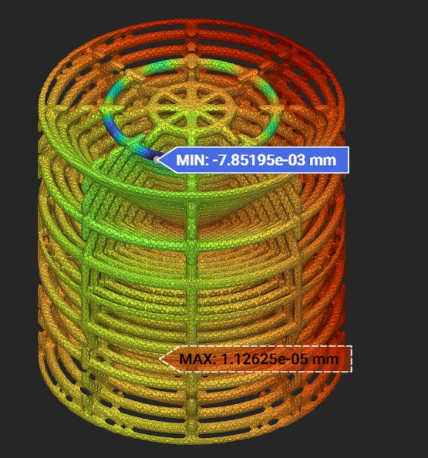
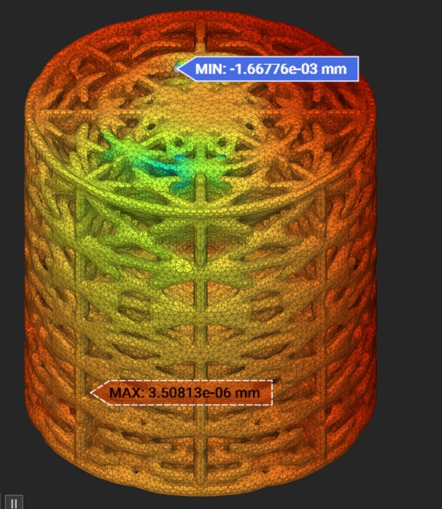
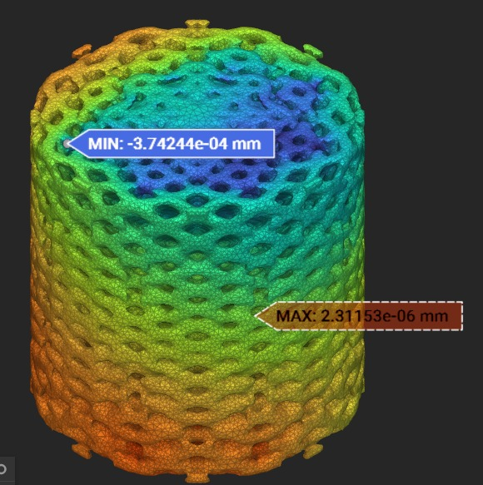
Displacement Field Results
For 0.75 mm strut thickness
BCC
Max displacement = 8.593 X 10⁻⁴ mm
SC
Max displacement = 7.8519 X 10⁻³ mm
FCC
Max displacement = 1.6677 X 10⁻³ mm
Fluorite
Max displacement = 3.7424 X 10⁻⁴ mm

Slide 10
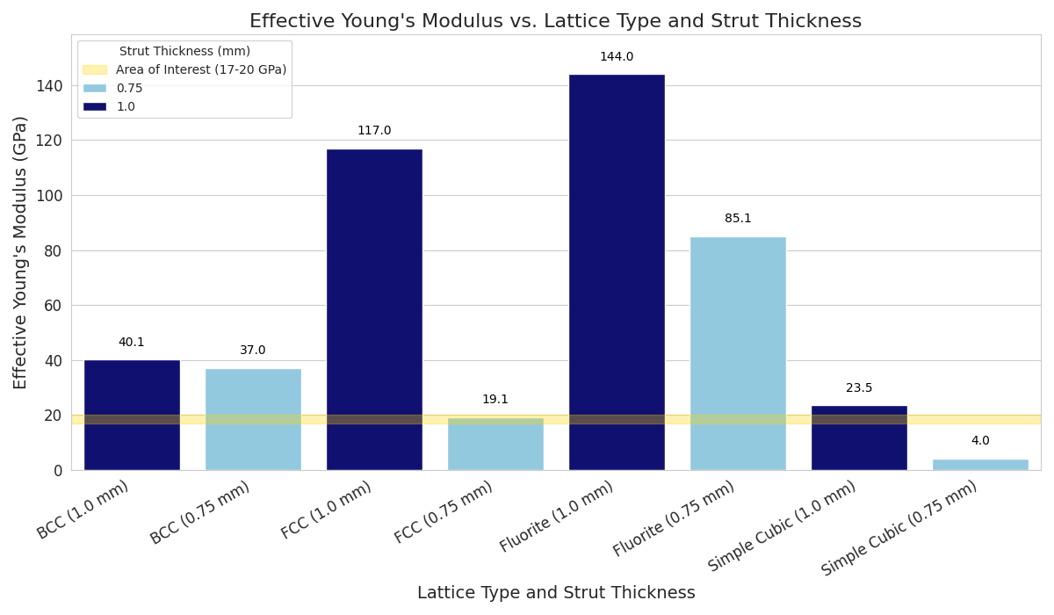
Effective Young’s Modulus
Fluorite lattice shows the highest stiffness
FCC is second strongest structure
Simple Cubic shows the largest deformation → lowest stiffness
Increasing strut thickness increases stiffness in all cases
FCC (0.75 mm) and Simple Cubic (1 mm) have Young’s modulus comparable to femoral bone
Results sheet

Slide 11
Conclusion
Development and evaluation of lattice‑based scaffold structures for bone analogous applications
Consistent framework for comparing the macroscopic stiffness behaviour of different lattice structures
FCC lattice with 0.75 mm thick struts and the Simple Cubic lattice with 1 mm struts, which can be used for the design of femoral scaffolds

Slide 12
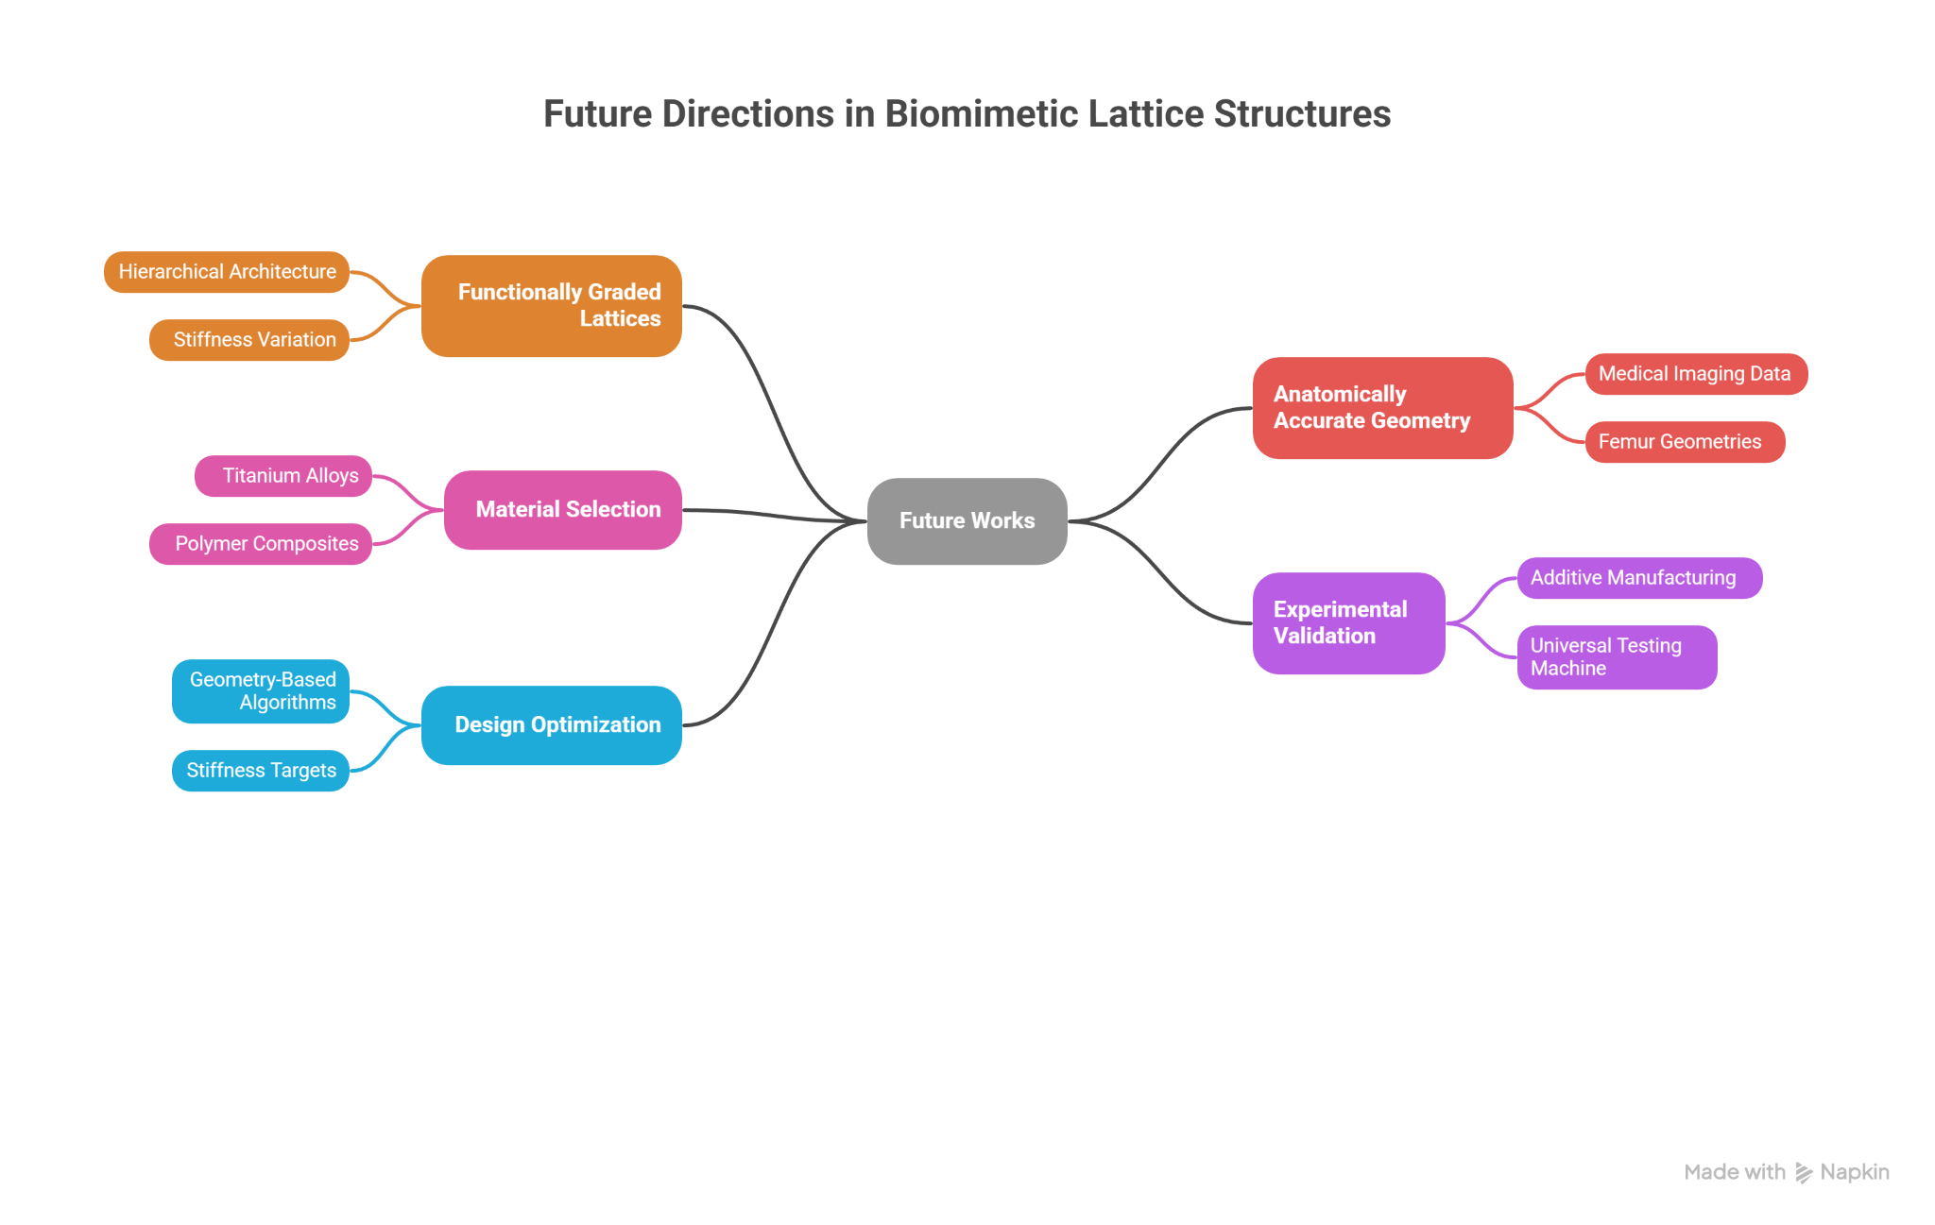
Future Work

Slide 13
Thank you

